Slide 1
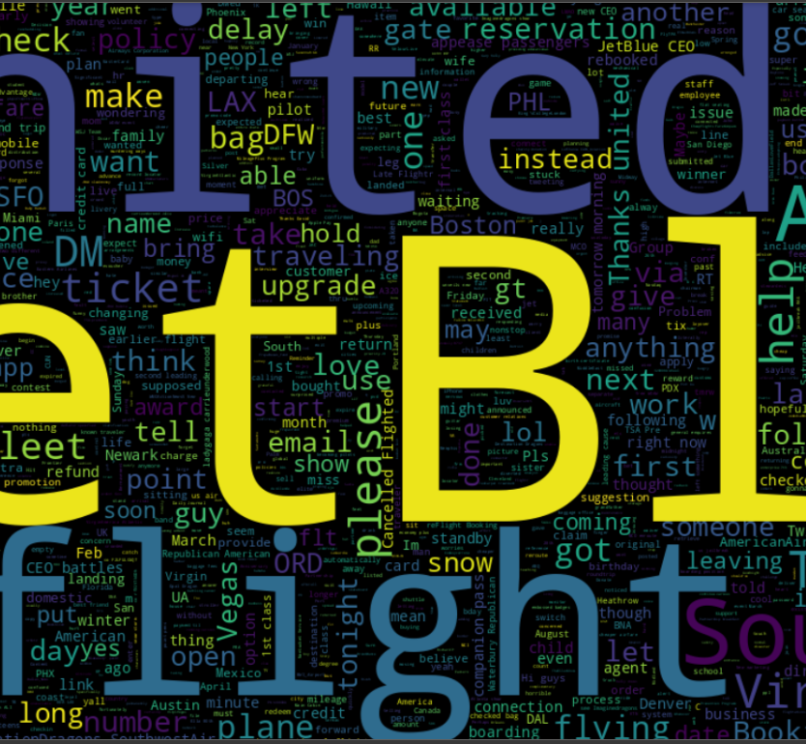
TWITTER FLIGHT SENTIMENT ANALYSIS
Amandeep saroA

Slide 2
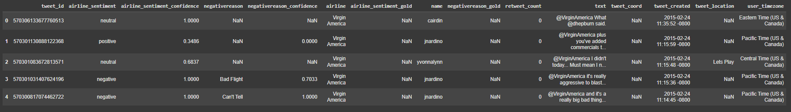
DATASET
WHERE? Sourced from Kaggle.
WHEN?: Data collected for the month of February 2015.
HOW? Approx. 14,000 tweets, analyzing how travelers expressed their feelings about U.S. airlines on Twitter.

Slide 3
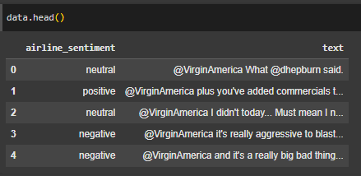
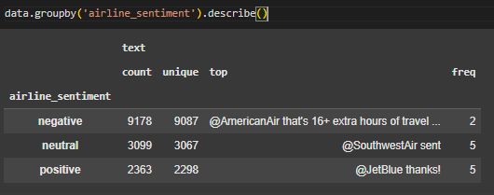
Data Preprocessing
SELECTING RELVANT COLUMN: Focused on the airline sentiment and text columns.
Code Snippet: data = df[["airline_sentiment", "text"]]
Sample Output:
Grouped data by airline sentiment:

Slide 4
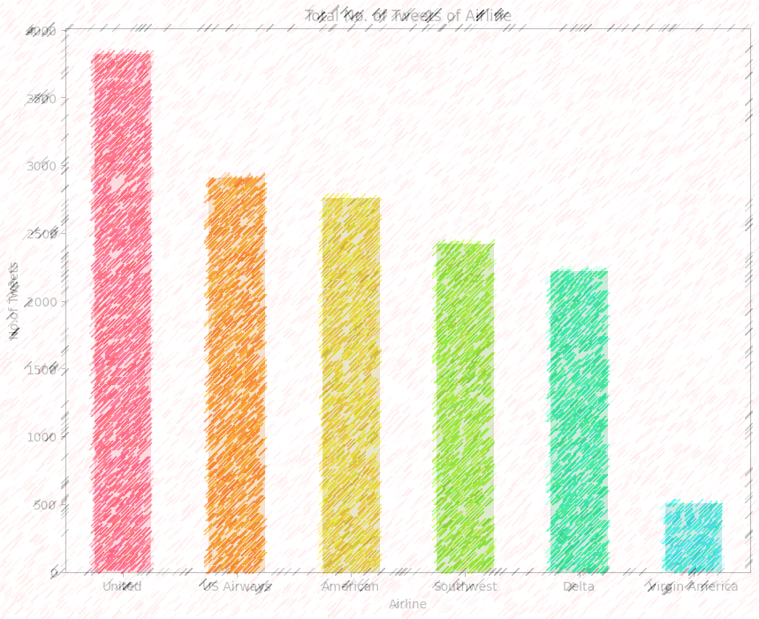
DATA VISUALIZATION

Slide 5
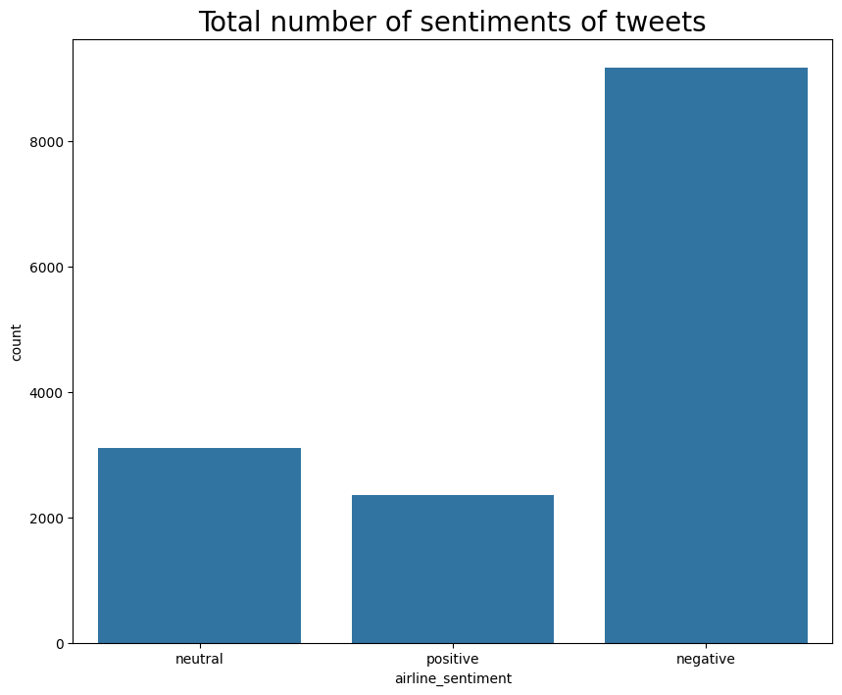
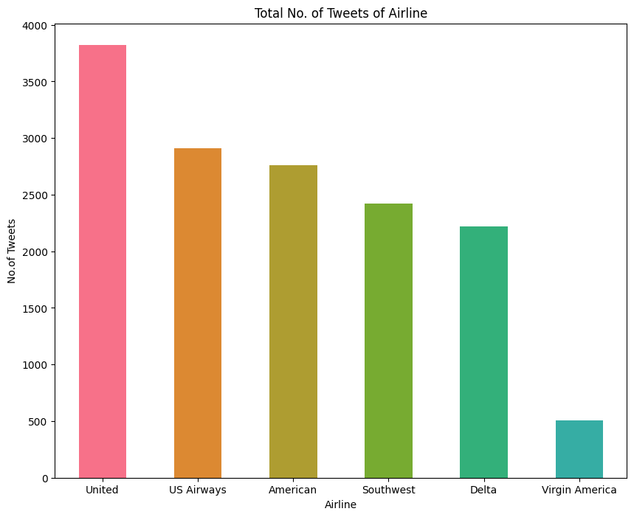
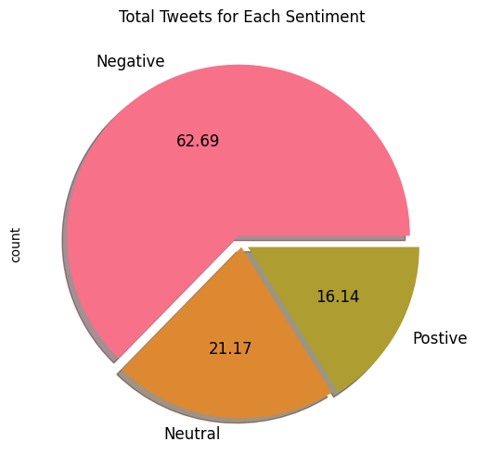
GRAPH’s

Slide 6
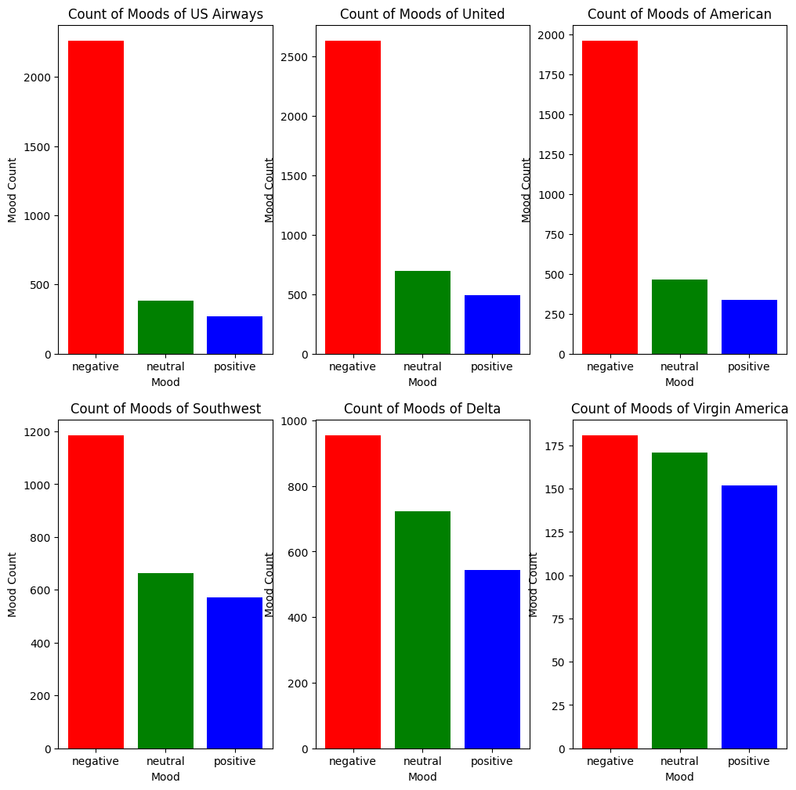

Slide 7
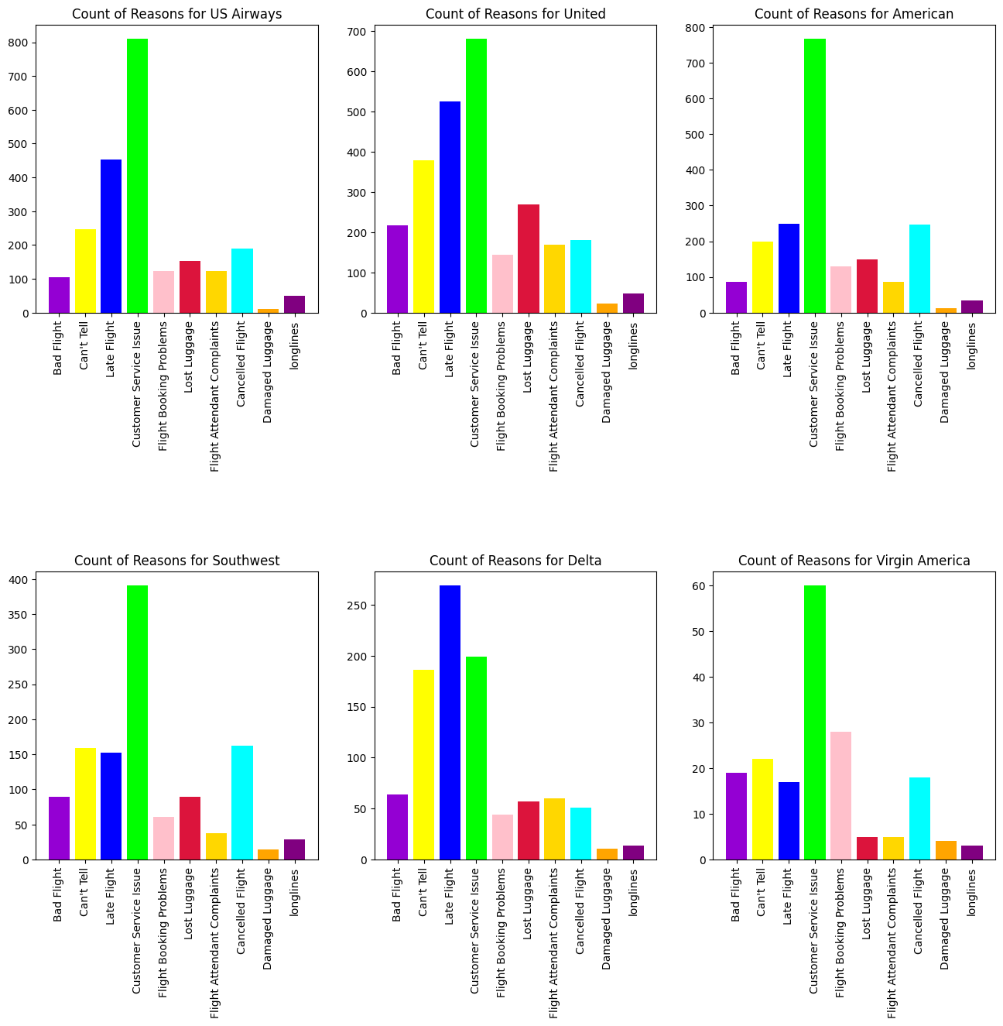

Slide 8
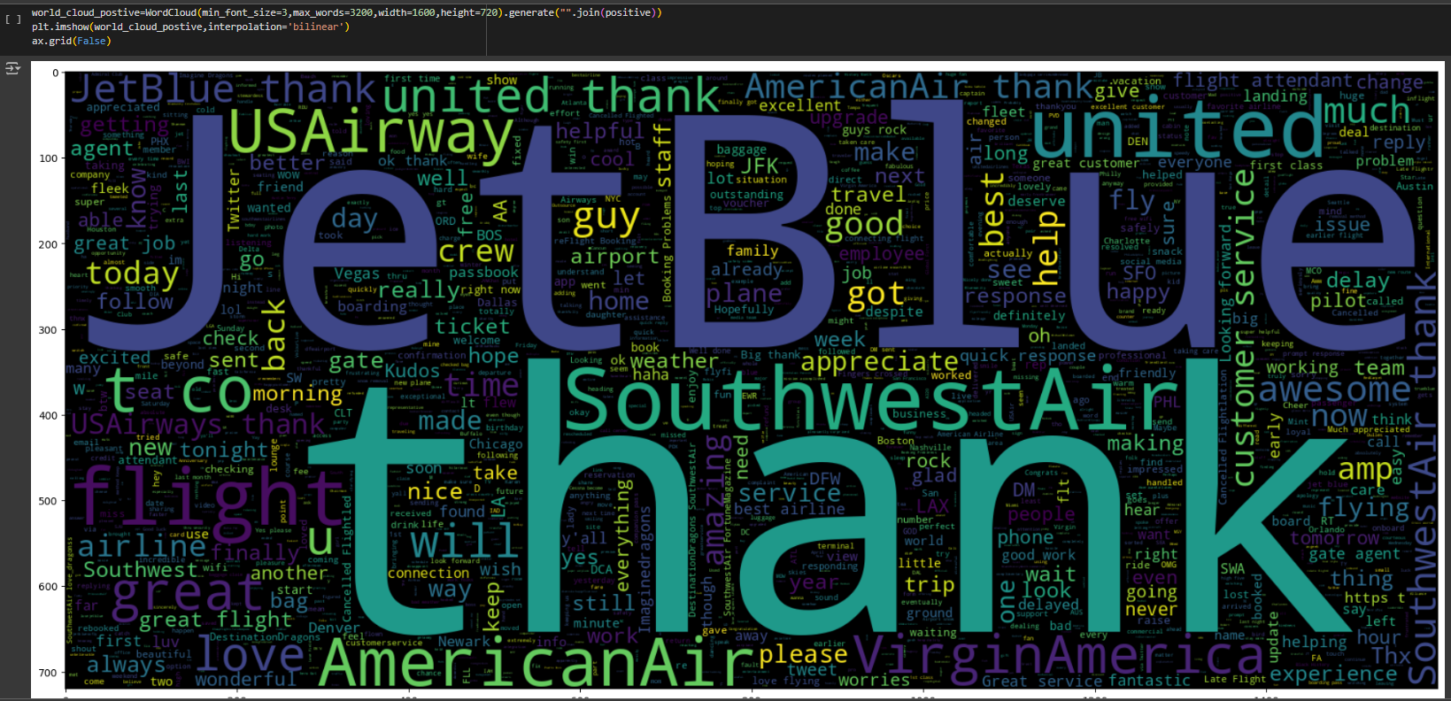

Slide 9
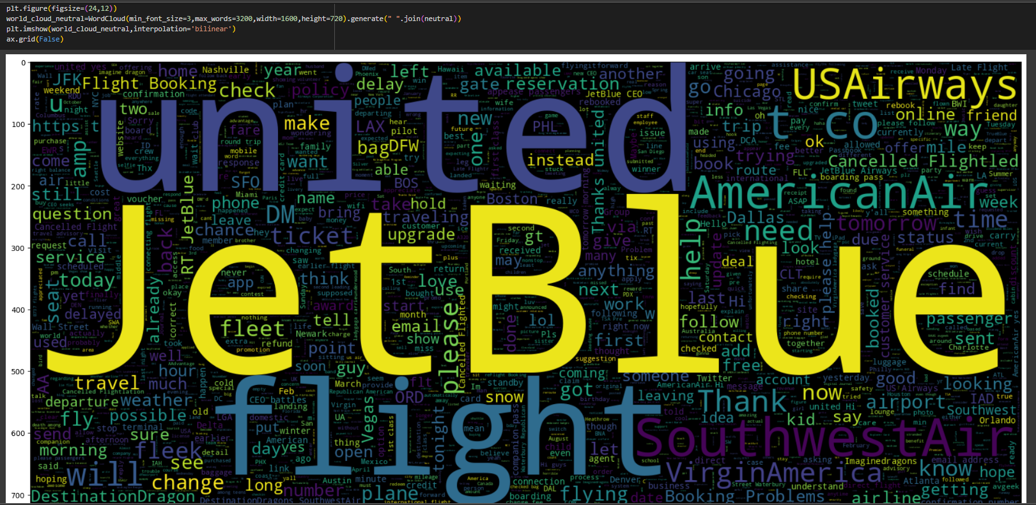

Slide 10
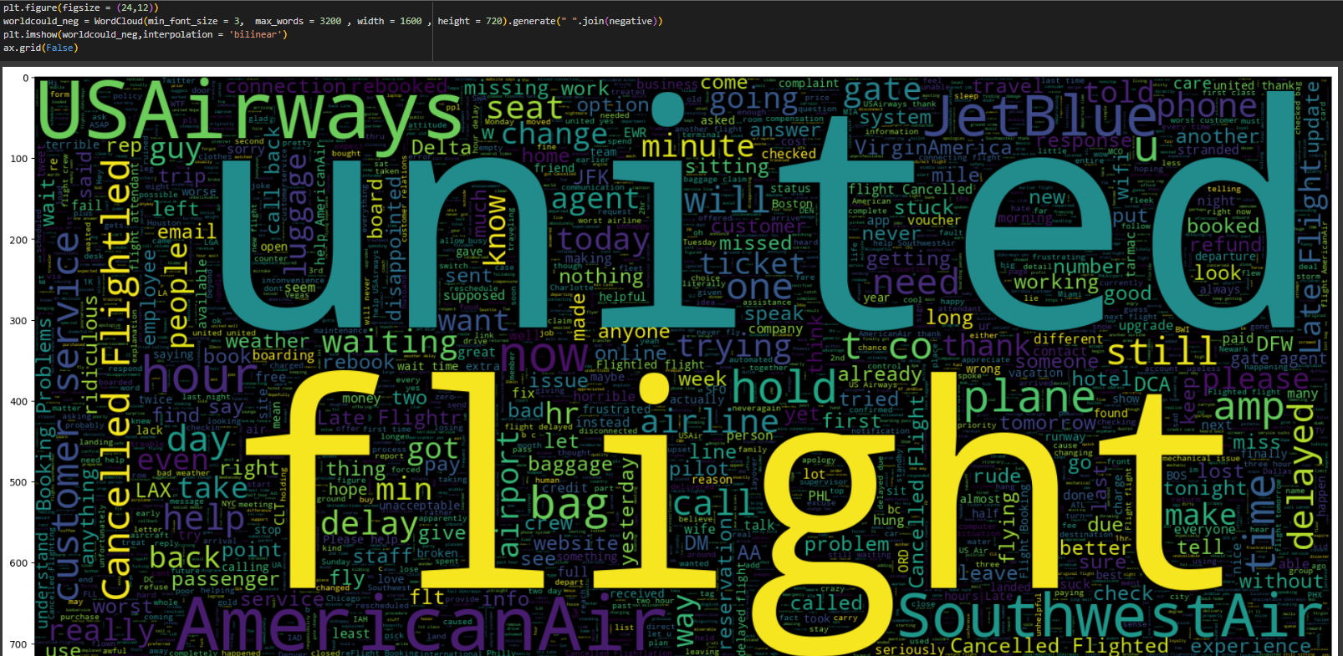

Slide 11


TEXT PROCESSING & CLEANING
{RegEx}
Sentiment Conversion
Remove Unnecessary text
Apply RegEx
Airline sentiment to numerical values: 0,1,2
Stopwords Removal
URL
Punctuation Removal
HTML Tag Removal
Username Removal
Emoji Removal
Decontraction:
Alphanumeric Separation
Character Normalization
Lowercasing

Slide 12
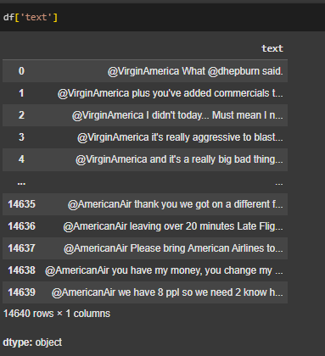
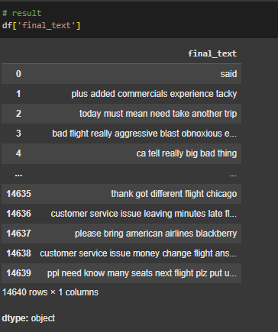

BEFORE:
AFTER:
success

Slide 13



TRAINING MACHINE LEARNING MODEL
TF-IDF Vectorizer
SMOTE
Train-Test Split
Convert the processed text into numerical features.
capture the importance of words in each tweet.
Giving more weight to unique words within each tweet.
Synthetic Minority Oversampling Technique.
Balance the dataset by generating synthetic samples.
How? ensuring that each sentiment class (positive, neutral, negative) has an equal representation in the training data, which improves model performance.
Training and Testing sets (75% training, 25% testing).
Train the model and evaluate its performance on unseen data, ensuring generalizability

Slide 14
ALGORITHMS APPLIED
XGBoost Classifier
Random Forest
Gradient boosting classifier
Support Vector Machine (SVM)
Naïve BAYES
DECISION TREE
Each algorithm uses a different approach to learn from the data.
Helps in finding the most effective model for our task.

Slide 15
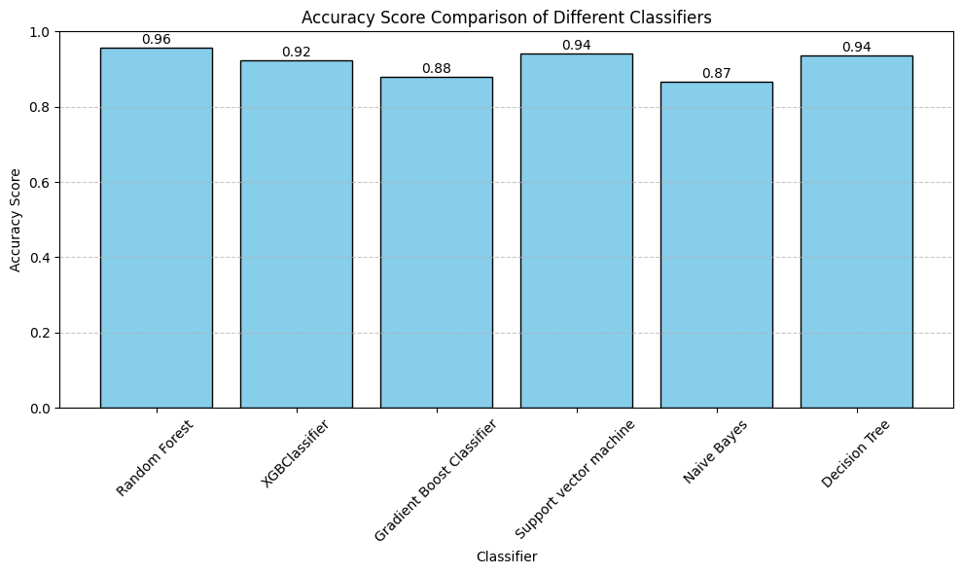
ACCURACY SCORE ACHIEVED
The Random Forest Algo. model achieved the highest accuracy score of 0.96.
Suggesting: Learned patterns effectively from the training data and applied them accurately on new, unseen data.

Slide 16
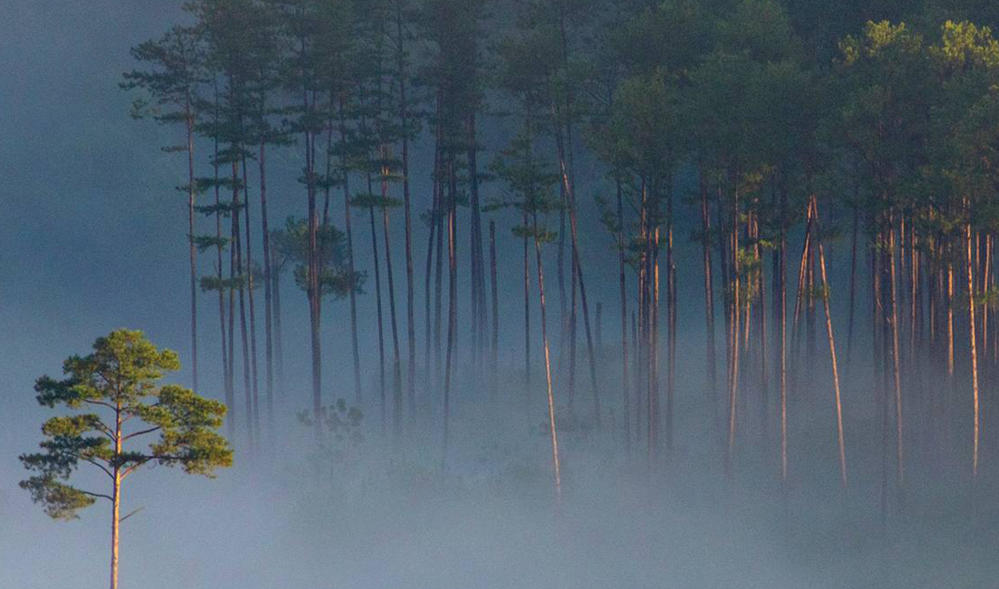
Thank you
AMANDEEP SAROA
amandeep.saroa@ontariotechu.net https://amandeepsaroaportfolio.netlify.app/

